Slide 1
UMET9G-30-1 Accounting & Finance for Decision Making Time Value of Money - Part 2
Presented by
Module Leader

Slide 2

Recap
Last weeks session covered:
The concept of time in finance
Simple vs compound interest
Calculation of the present value and the future value of a single cashflow
Notes:
NOTE TO STUDENTS: Please see last weeks lecture slides and make sure you review them so that you understand how you will be assessed and what resources we provide to support you in success.

Slide 3
Learning Outcomes
Calculations surrounding multiple cashflows
Calculations for growing annuities and perpetuities
Calculations for annuities and perpetuities

Slide 4
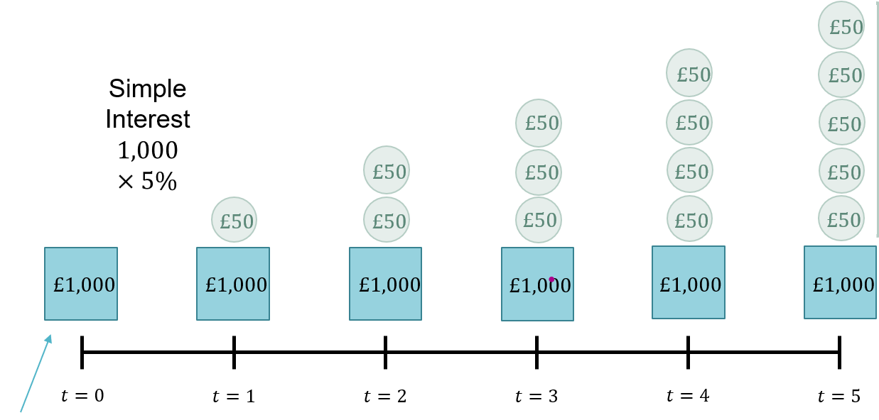
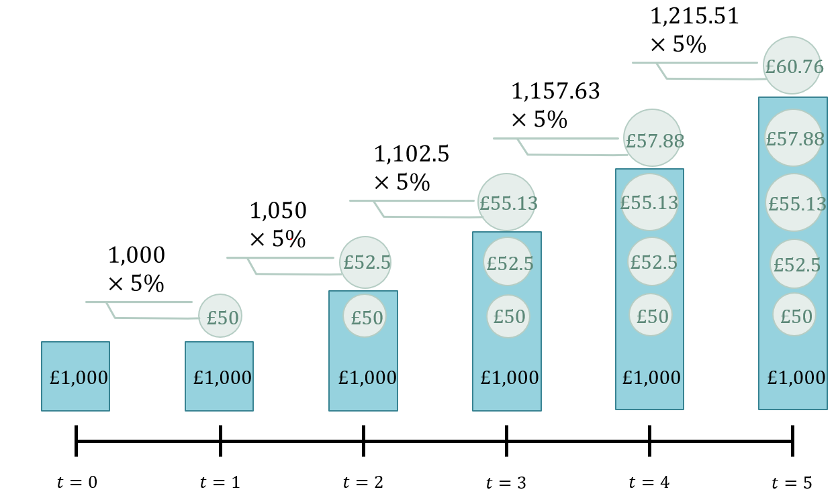

Recap
The concept of time in finance – a basic problem for the Financial Manager is how to determine the value of future cashflows.
Simple vs Compounding Interest
The present value and discounting
vs
The future value and compounding
This Photo by Unknown Author is licensed under CC BY-SA

Slide 5


TVM formulae - Roundup
Simple interest
$$FV=PV×\left(1+rt\right)$$
$$PV=FV×{\left(1+rt\right)}^{−1}$$
Compound interest
$$FV=PV×{\left(1+r\right)}^{t}$$
$$PV=FV×{\left(1+r\right)}^{−t}$$
$${r=\left(\frac{FV}{PV}\right)}^{\frac{1}{t}}$$
$$t=\frac{\ln\left(\frac{FV}{PV}\right)}{ln⁡(1+r)}$$
- Continuous compounding
$$FV=PV×e^{rt}$$
$$PV=FV×e^{−rt}$$

Slide 6



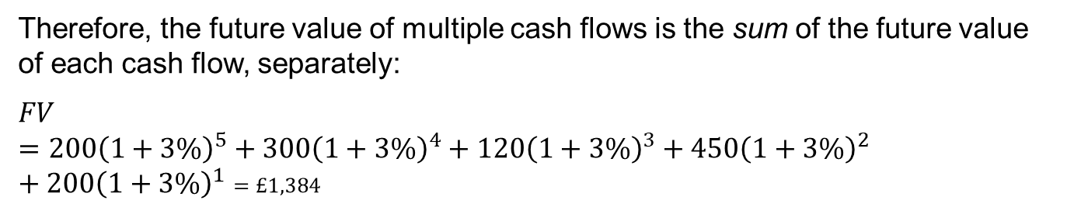



















Multiple cash flows
We could use the future value of each deposit separately. $FV=PV×{\left(1+r\right)}^{t}$
$$×{\left(1+3\%\right)}^{5}$$
$$£232$$
$$×{\left(1+3\%\right)}^{4}$$
$$£338$$
$$×{\left(1+3\%\right)}^{3}$$
$$£131$$
$$£1,384$$
$$×{\left(1+3\%\right)}^{2}$$
$$£477$$
$$£200$$
$$×{\left(1+3\%\right)}^{1}$$
$$£206$$
$$£300$$
$$£120$$
$$£450$$
$$£200$$
$$t=0$$
$$t=1$$
$$t=2$$
$$t=3$$
$$t=4$$
$$t=5$$
Therefore, the future value of multiple cash flows is the sum of the future value of each cash flow, separately:
$$FV=200{\left(1+3\%\right)}^{5}+300{\left(1+3\%\right)}^{4}+120{\left(1+3\%\right)}^{3}+450{\left(1+3\%\right)}^{2}+200{\left(1+3\%\right)}^{1}=£1,384$$
Notes:
Compounding

Slide 7

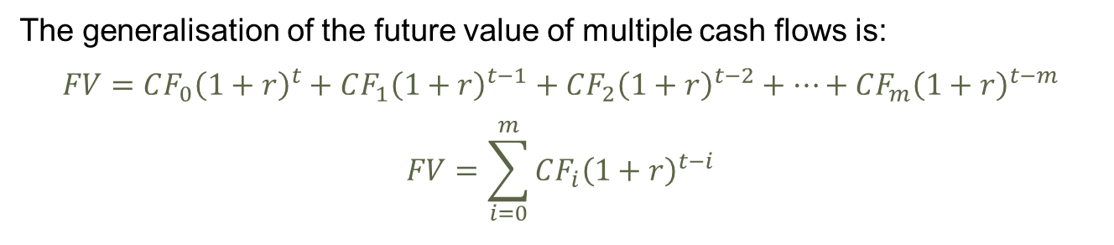
Multiple cash flows - FV
The generalisation of the future value of multiple cash flows is:
$$FV=CF_{0}{\left(1+r\right)}^{t}+CF_{1}{\left(1+r\right)}^{t−1}+CF_{2}{\left(1+r\right)}^{t−2}+…+CF_{m}{\left(1+r\right)}^{t−m}$$
$$FV=\sum_{i=0}^{m}{CF_{i}{\left(1+r\right)}^{t−i}}$$
Where $CF_{i}$: the cash flow in year $i$.

Slide 8


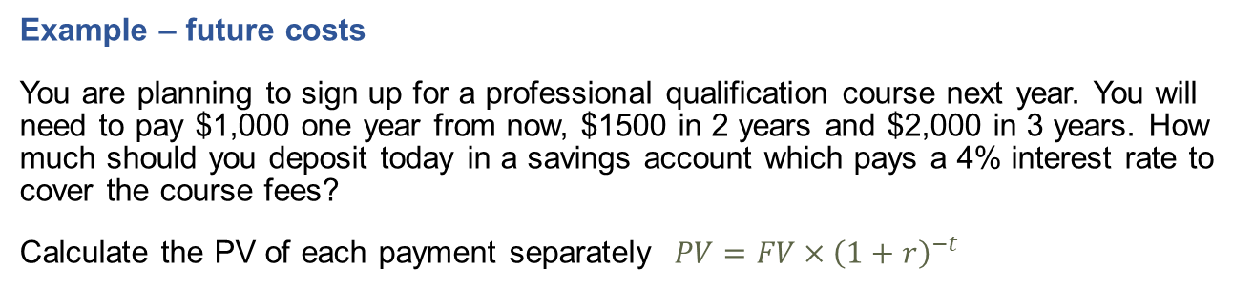

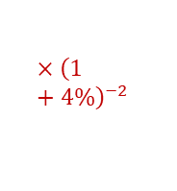










Multiple cash flows - PV
Example – future costs
You are planning to sign up for a professional qualification course next year. You will need to pay $1,000 one year from now, $1500 in 2 years and $2,000 in 3 years. How much should you deposit today in a savings account which pays a 4% interest rate to cover the course fees?
Calculate the PV of each payment separately $PV=FV×{\left(1+r\right)}^{−t}$
$$\$1,778$$
$$×{\left(1+4\%\right)}^{−3}$$
$$\$1,387$$
$$×{\left(1+4\%\right)}^{−2}$$
$$\$962$$
$$×{\left(1+4\%\right)}^{−1}$$
$$\$1,000$$
$$\$1,500$$
$$\$2,000$$
$$t=0$$
$$t=1$$
$$t=2$$
$$t=3$$
$$Σ=\$4,126$$
Notes:
Discounting

Slide 9
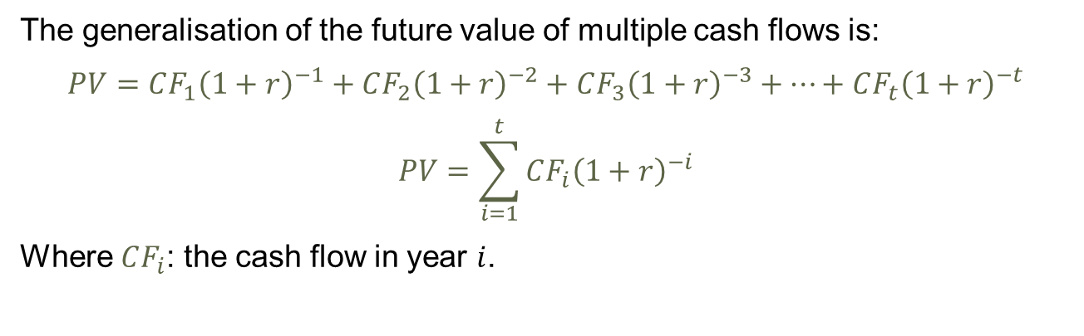
Multiple Cash Flows – PV
This is the same as:
$$PV=1,000×{\left(1+4\%\right)}^{−1}+1,500×{\left(1+4\%\right)}^{−2}+2,000×{\left(1+4\%\right)}^{−3}=\$4,126$$
The generalisation of the future value of multiple cash flows is:
$$PV=CF_{1}{\left(1+r\right)}^{−1}+CF_{2}{\left(1+r\right)}^{−2}+CF_{3}{\left(1+r\right)}^{−3}+…+CF_{t}{\left(1+r\right)}^{−t}$$
$$PV=\sum_{i=1}^{t}{CF_{i}{\left(1+r\right)}^{−i}}$$
Where $CF_{i}$: the cash flow in year $i$.
Notes:
Example of PV of multiple cash flows – Future dividends
You hold a number of shares in a company which will cease its operations in 5 years. The company will pay you the following dividends: £200 in year 1; £140 in year 2; £112 in year 3; £230 in year 4; and a final dividend of £300 in year 5. Using a discount rate of 5%, what is the present value of your future dividends?

Slide 10

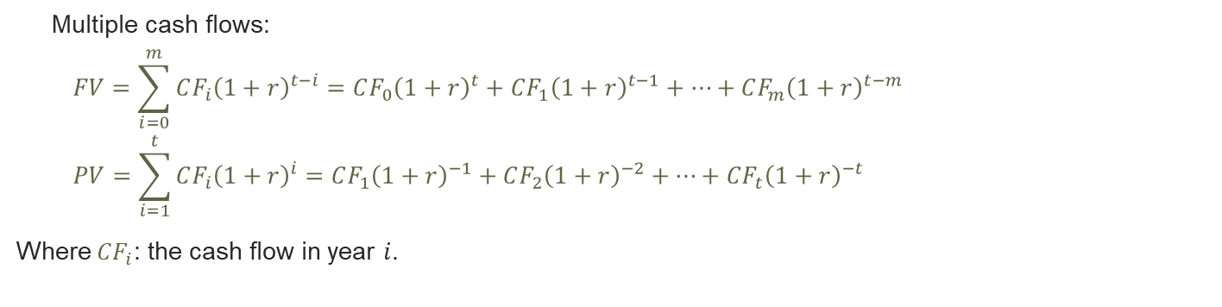

TVM recap
The future and present values over $t$ years using an annual interest rate, $n$ times in a year:
Compound interest
$$FV=PV×{\left(1+r\right)}^{t}$$
$$PV=FV×{\left(1+r\right)}^{−t}$$
$${r=\left(\frac{FV}{PV}\right)}^{\frac{1}{t}}$$
$$t=\frac{\ln\left(\frac{FV}{PV}\right)}{ln⁡(1+r)}$$
Continuous compounding
$$FV=PV×e^{rt}$$
$$PV=FV×e^{−rt}$$
Multiple cash flows:
$$FV=\sum_{i=0}^{m}{CF_{i}{\left(1+r\right)}^{t−i}}=CF_{0}{\left(1+r\right)}^{t}+CF_{1}{\left(1+r\right)}^{t−1}+…+CF_{m}{\left(1+r\right)}^{t−m}$$
$$PV=\sum_{i=1}^{t}{CF_{i}{\left(1+r\right)}^{i}}=CF_{1}{\left(1+r\right)}^{−1}+CF_{2}{\left(1+r\right)}^{−2}+…+CF_{t}{\left(1+r\right)}^{−t}$$
Where $CF_{i}$: the cash flow in year $i$.

Slide 11

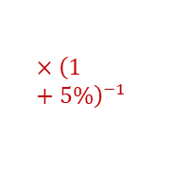
















Annuity
What if the cash flow, $CF_{i}$, is constant every year (an annuity)?
Terminology
Annuity = a constant annual cash flow.
11
Example
Consider an investment plan which pays out £1k annually for 10 years. Using a discount rate of 5%, What is the value of this investment to you today.
Cashflow timeline
$$£613.91.$$
$$×{\left(1+5\%\right)}^{−10}$$
$$£863.84$$
$$£907.03$$
$$×{\left(1+5\%\right)}^{−3}$$
$$£952.38$$
$$×{\left(1+5\%\right)}^{−2}$$
$$×{\left(1+5\%\right)}^{−1}$$
$$£1,000$$
$$£1,000$$
$$£1,000$$
$$£1,000$$
$$t=0$$
$$t=1$$
$$t=2$$
$$t=3$$
$$…$$
$$t=10$$

Slide 12
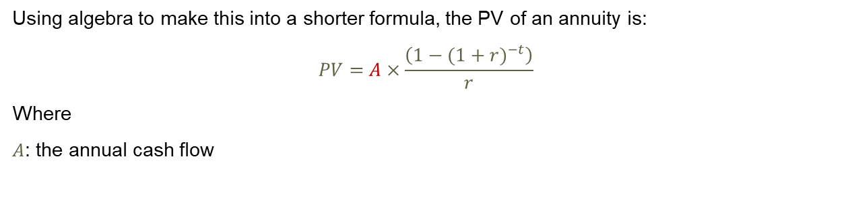
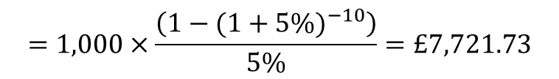
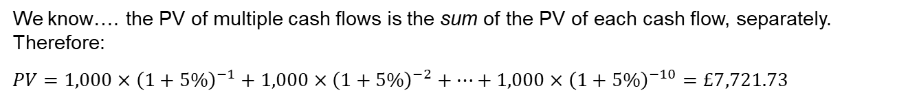
Annuity – PV
We know…. the PV of multiple cash flows is the sum of the PV of each cash flow, separately. Therefore:
$$PV=1,000×{\left(1+5\%\right)}^{−1}+1,000×{\left(1+5\%\right)}^{−2}+…+1,000×{\left(1+5\%\right)}^{−10}=£7,721.73$$
$BUT…$this is tedious, and time consuming and what if it was over 50 years or 100 years…
Using algebra to make this into a shorter formula, the PV of an annuity is:
$$PV=A×\frac{\left(1−{(1+r)}^{−t}\right)}{r}$$
Where
$A$: the annual cash flow
$$=1,000×\frac{\left(1−{(1+5\%)}^{−10}\right)}{5\%}=£7,721.73$$

Slide 13

Annuity - FV
Future Value
You won a prize which pays you yearly £2,000 for the next 20 years. Using a compound rate of 7%, how much would you have received after 20 years?
Rearranging the PV annuity formula, we get the FV formula for an annuity:
$$FV=A×\frac{\left({\left(1+r\right)}^{t}−1\right)}{r}$$
Notes:
$$FV=2,000×\frac{\left({\left(1+7\%\right)}^{20}−1\right)}{7\%}=£81,990.98$$

Slide 14
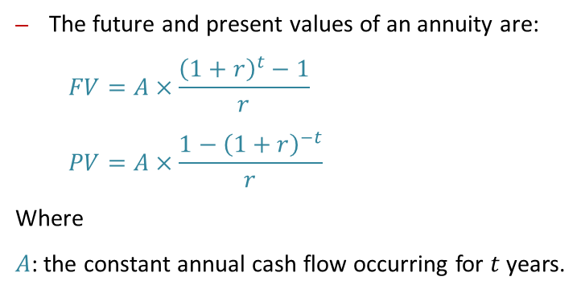
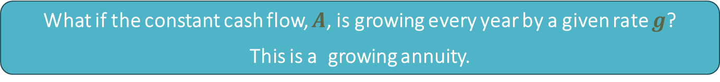
Annuity - recap
The future and present values of an annuity are:
$$FV=A×\frac{{\left(1+r\right)}^{t}−1}{r}$$
$$PV=A×\frac{1−{\left(1+r\right)}^{−t}}{r}$$
Where
$A$: the constant annual cash flow occurring for $t$ years.
What if the constant cash flow, $A$, is growing every year by a given rate $g$?
This is a growing annuity.

Slide 15














Growing Annuity PV
Example You can choose between apartments starting next year for 10 years. Using a discount rate of 3%, which apartment has the lowest living costs over the 10 years?
Apt 1: the annual costs are £10,000 per year, and will grow by 5% every year.
Apt 2: the annual living costs are £12,000 per year, and will grow by 1% every year.
Here we have a growing annuity.
Apt 1 timeline
$$×{\left(1+3\%\right)}^{−10}$$
$$×{\left(1+3\%\right)}^{−3}$$
$$×{\left(1+3\%\right)}^{−2}$$
$$×{\left(1+3\%\right)}^{−1}$$
$$×(1+5\%)$$
$$×(1+5\%)$$
$$×(1+5\%)$$
$$£10,000$$
$$£10,000×(1+5\%)$$
$$£10,000×{\left(1+5\%\right)}^{2}$$
$£10,000×{\left(1+5\%\right)}^{9}$
$$t=0$$
$$t=1$$
$$t=2$$
$$t=3$$
$$…$$
$$t=10$$

Slide 16
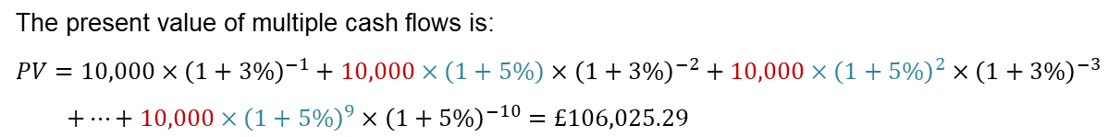
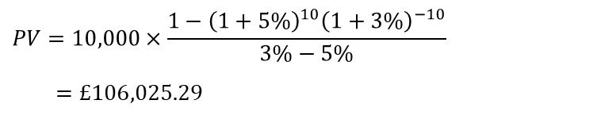
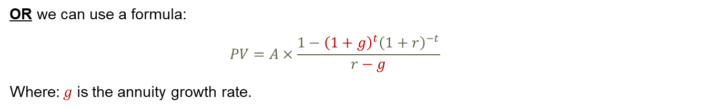
Growing Annuity – Present Value
The present value of multiple cash flows is:
$$PV=10,000×{\left(1+3\%\right)}^{−1}+10,000×\left(1+5\%\right)×{\left(1+3\%\right)}^{−2}+10,000×{\left(1+5\%\right)}^{2}×{\left(1+3\%\right)}^{−3}$$
$$+…+10,000×{\left(1+5\%\right)}^{9}×{\left(1+5\%\right)}^{−10}=£106,025.29$$
OR we can use a formula:
$$PV=A×\frac{1−{\left(1+g\right)}^{t}{\left(1+r\right)}^{−t}}{r−g}$$
Where: $g$ is the annuity growth rate.
$$PV=10,000×\frac{1−{\left(1+5\%\right)}^{10}{\left(1+3\%\right)}^{−10}}{3\%−5\%}$$
$$=£106,025.29$$

Slide 17


Growing Annuity
We know, the present value of a growing annuity is
$$PV=A×\frac{1−{\left(1+g\right)}^{t}{\left(1+r\right)}^{−t}}{r−g}$$
This can be arranged to formulate the Future Value
$$FV=A×\frac{{\left(1+r\right)}^{t}−{\left(1+g\right)}^{t}}{r−g}$$

Slide 18
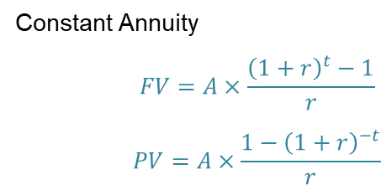
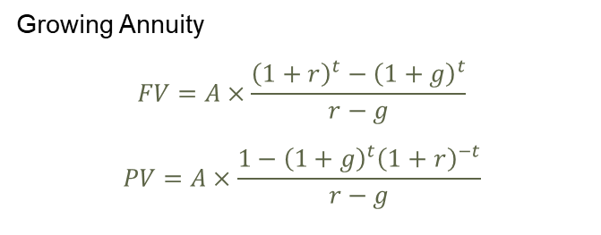
Annuity recap
Constant Annuity
$$FV=A×\frac{{\left(1+r\right)}^{t}−1}{r}$$
$$PV=A×\frac{1−{\left(1+r\right)}^{−t}}{r}$$
Growing Annuity
$$FV=A×\frac{{\left(1+r\right)}^{t}−{\left(1+g\right)}^{t}}{r−g}$$
$$PV=A×\frac{1−{{\left(1+g\right)}^{t}\left(1+r\right)}^{−t}}{r−g}$$
What if the annuity goes on forever? This is called a Perpetuity.

Slide 19
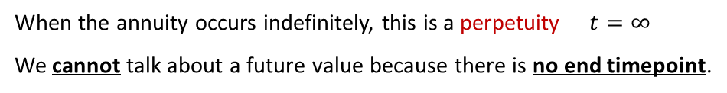
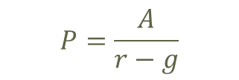

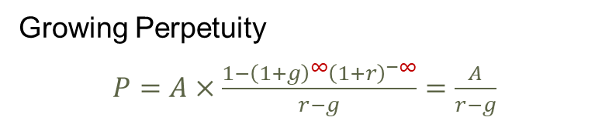

Perpetuity
When the annuity occurs indefinitely, this is a perpetuity $t=∞$
We cannot talk about a future value because there is no end timepoint.
Constant Perpetuity
$P=A×\frac{1−{\left(1+r\right)}^{−∞}}{r}$ $=A×\frac{1}{r}=\frac{A}{r}$
$P=\frac{A}{r}$
Growing Perpetuity
$P=A×\frac{1−{{\left(1+g\right)}^{∞}\left(1+r\right)}^{−∞}}{r−g}=\frac{A}{r−g}$
$$P=\frac{A}{r−g}$$
Example Your broker suggested two investment plans
Investment 1: pays you annually £5,000 forever.
Investment 2: pays you annually £2,000, growing at 1.5% rate forever.
Using a discount rate of 6%, which investment plan would you choose?

Slide 20
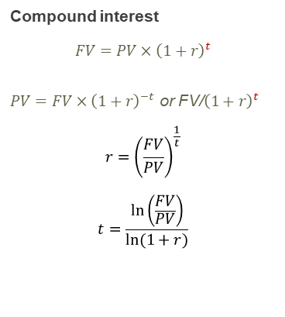

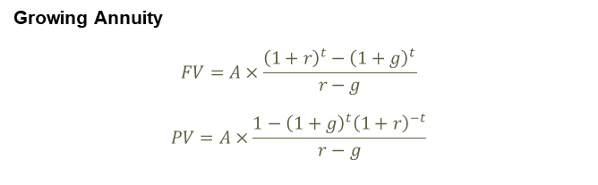

TVM recap
Continuous compounding
$$FV=PV×e^{rt}$$
$$PV=FV×e^{−rt}$$
Multiple cash flows:
$$FV=\sum_{i=0}^{m}{CF_{i}{\left(1+r\right)}^{t−i}}=CF_{0}{\left(1+r\right)}^{t}+CF_{1}{\left(1+r\right)}^{t−1}+…+CF_{m}{\left(1+r\right)}^{t−m}$$
$$PV=\sum_{i=1}^{t}{CF_{i}{\left(1+r\right)}^{i}}=CF_{1}{\left(1+r\right)}^{−1}+CF_{2}{\left(1+r\right)}^{−2}+…+CF_{t}{\left(1+r\right)}^{−t}$$
Compound interest
$$FV=PV×{\left(1+r\right)}^{t}$$
$PV=FV×{\left(1+r\right)}^{−t}$ or FV/${\left(1+r\right)}^{t}$
$${r=\left(\frac{FV}{PV}\right)}^{\frac{1}{t}}$$
$$t=\frac{\ln\left(\frac{FV}{PV}\right)}{ln⁡(1+r)}$$
Constant Annuity
$$FV=A×\frac{{\left(1+r\right)}^{t}−1}{r}$$
$$PV=A×\frac{1−{\left(1+r\right)}^{−t}}{r}$$
Growing Annuity
$$FV=A×\frac{{\left(1+r\right)}^{t}−{\left(1+g\right)}^{t}}{r−g}$$
$$PV=A×\frac{1−{{\left(1+g\right)}^{t}\left(1+r\right)}^{−t}}{r−g}$$
Constant perpetuity Growing perpetuity
$P=\frac{A}{r}$ $P=\frac{A}{r−g}$

Slide 21
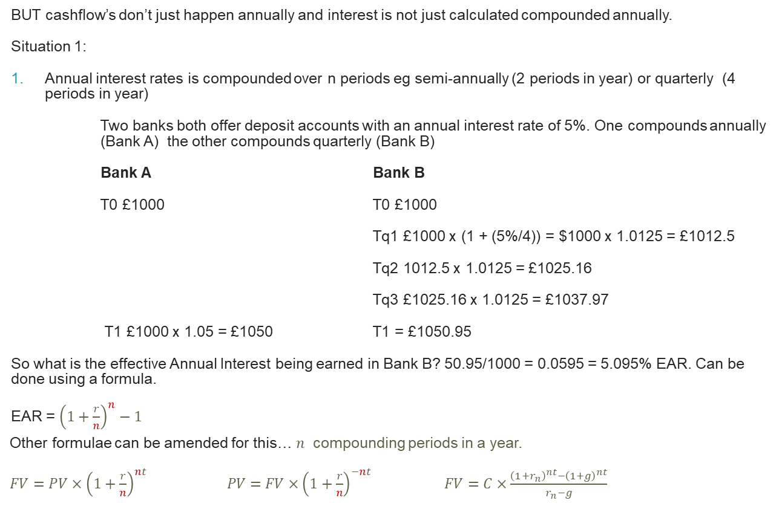
Compounding periods
BUT cashflow’s don’t just happen annually and interest is not just calculated compounded annually.
Situation 1:
Annual interest rates is compounded over n periods eg semi-annually (2 periods in year) or quarterly (4 periods in year)
Two banks both offer deposit accounts with an annual interest rate of 5%. One compounds annually (Bank A) the other compounds quarterly (Bank B)
Bank A Bank B
T0 £1000 T0 £1000
Tq1 £1000 x (1 + (5%/4)) = $1000 x 1.0125 = £1012.5
Tq2 1012.5 x 1.0125 = £1025.16
Tq3 £1025.16 x 1.0125 = £1037.97
T1 £1000 x 1.05 = £1050 T1 = £1050.95
So what is the effective Annual Interest being earned in Bank B? 50.95/1000 = 0.0595 = 5.095% EAR. Can be done using a formula.
EAR = ${\left(1+\frac{r}{n}\right)}^{n}−1$
Other formulae can be amended for this… 𝑛 compounding periods in a year.
$FV=PV×{\left(1+\frac{r}{n}\right)}^{nt} PV=FV×{\left(1+\frac{r}{n}\right)}^{−nt}$ $FV=C×\frac{{\left(1+r_{n}\right)}^{nt}−{\left(1+g\right)}^{nt}}{r_{n}−g}$

Slide 22
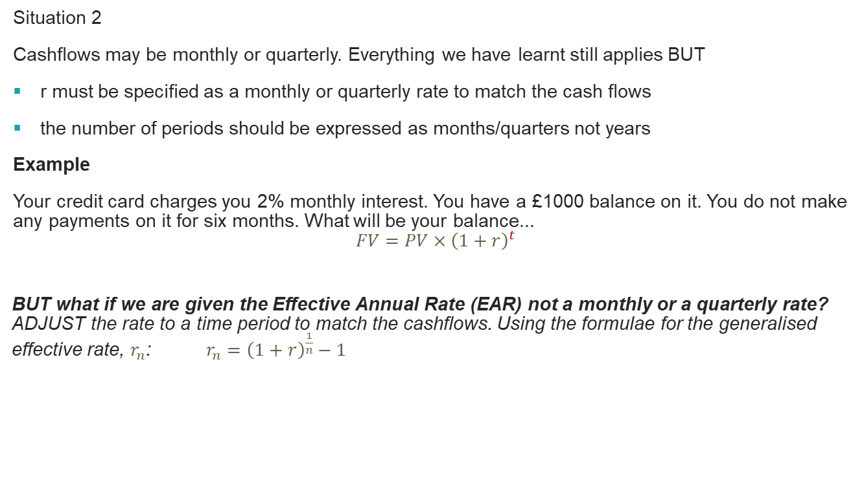
Non annual cashflows
Situation 2
Cashflows may be monthly or quarterly. Everything we have learnt still applies BUT
r must be specified as a monthly or quarterly rate to match the cash flows
the number of periods should be expressed as months/quarters not years
Example
Your credit card charges you 2% monthly interest. You have a £1000 balance on it. You do not make any payments on it for six months. What will be your balance...
$$FV=PV×{\left(1+r\right)}^{t}$$
BUT what if we are given the Effective Annual Rate (EAR) not a monthly or a quarterly rate? ADJUST the rate to a time period to match the cashflows. Using the formulae for the generalised effective rate, $r_{n}$: $r_{n}={\left(1+r\right)}^{\frac{1}{n}}−1$
Notes:
r will be the monthly rate and t should be the months.1126.16

Slide 23

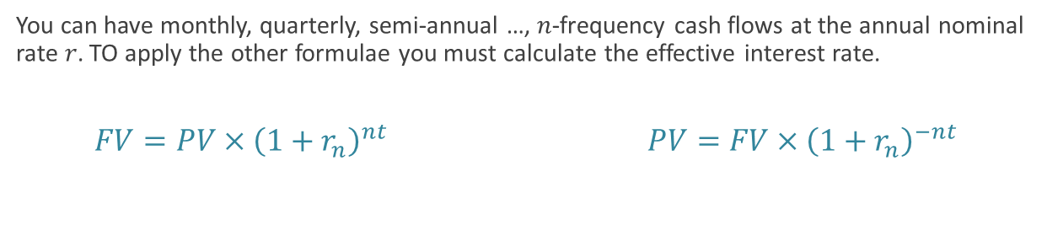
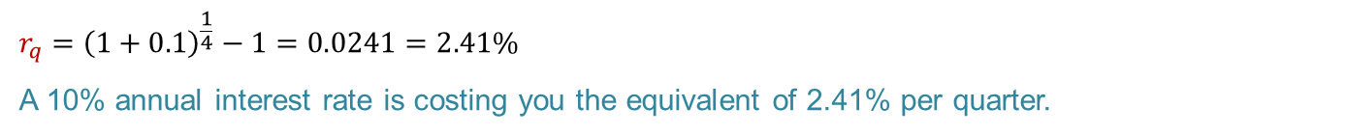
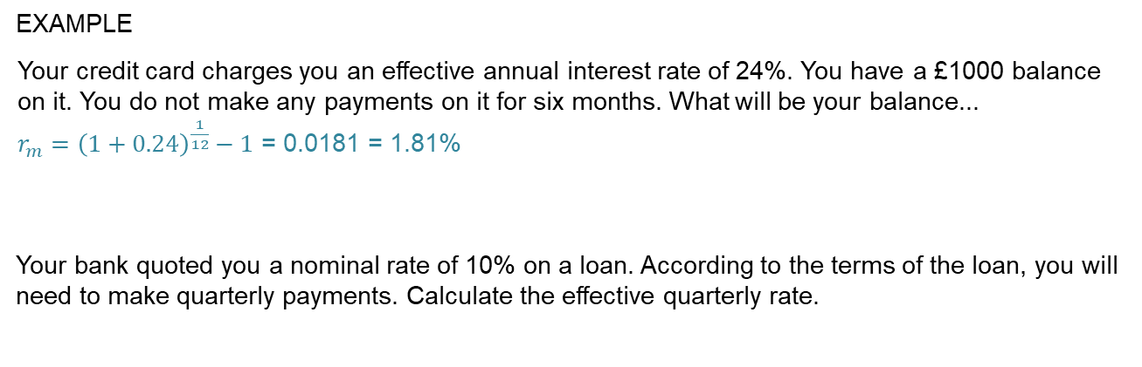
Effective Interest Rate
EXAMPLE
Your credit card charges you an effective annual interest rate of 24%. You have a £1000 balance on it. You do not make any payments on it for six months. What will be your balance...
$r_{m}={\left(1+0.24\right)}^{\frac{1}{12}}−1$ = 0.0181 = 1.81%
Your bank quoted you a nominal rate of 10% on a loan. According to the terms of the loan, you will need to make quarterly payments. Calculate the effective quarterly rate.
$$r_{q}={\left(1+0.1\right)}^{\frac{1}{4}}−1=0.0241=2.41\%$$
A 10% annual interest rate is costing you the equivalent of 2.41% per quarter.
You can have monthly, quarterly, semi-annual …, 𝑛-frequency cash flows at the annual nominal rate 𝑟. TO apply the other formulae you must calculate the effective interest rate.
$$FV=PV×{\left(1+r_{n}\right)}^{nt} PV=FV×{\left(1+r_{n}\right)}^{−nt}$$

Slide 24
Learning Outcomes Covered
Calculations surrounding multiple cashflows
Calculations for growing annuities and perpetuities
Calculations for annuities and perpetuities

Slide 25
Next Week
Investment Appraisal

